Slide 1
Data Structures and Algorithms -3 (25CS2103E)
Matrix Chain Multiplication Optimization Using Dynamic Programming
Team Members
GOPIREDDY SUSMITHA-2520030201
U. VARSHITHA-2520030206
CHALLA SREEJA-2520030219
Under the Esteemed Guidance of
D. Swathi

Slide 2
Contents
Abstract
Introduction
Literature survey
Problem Statement and Objectives
Hardware and Software requirements
Results
Conclusion
Future Scope

Slide 3
Abstract
Matrix Chain Multiplication finds the most efficient order for multiplying a sequence of matrices.
The project uses Dynamic Programming (Interval DP) to minimize the number of scalar multiplications.
It accepts matrix dimensions as input and generates the required matrices.
It creates DP cost and split tables to find the optimal multiplication order.
It displays the minimum multiplication cost and optimal parenthesization.
It compares the optimized DP approach with a naïve multiplication strategy.
The application is implemented using Java with an interactive interface.
Time Complexity: O(n³) | Space Complexity: O(n²).

Slide 4
Introduction
• Matrix Chain Multiplication deals with finding the best order to multiply a chain of matrices.
• Matrix multiplication is associative, so the order of parenthesization can be changed without changing the final result.
• However, different orders may require significantly different numbers of scalar multiplications.
• Dynamic Programming avoids repeatedly solving the same subproblems.
• The project uses Java to implement an optimization tool that finds the minimum multiplication cost and optimal parenthesization.

Slide 5
Literature Survey
Approach | Technique | Observation
Traditional approach | Fixed multiplication order | May perform unnecessary operations
Recursive approach | Recursion | Repeatedly solves subproblems
Dynamic Programming | Bottom-up DP | Avoids redundant calculations
Proposed system | Interval DP + comparison | Finds optimal order and compares cost
A practical tool that combines optimal parenthesization, cost analysis, and comparison with a naïve strategy provides a clearer demonstration of the benefits of Dynamic Programming.

Slide 6
Problem Statement and Objectives
Problem Statement:
Find the optimal order of multiplying a sequence of matrices so that the number of required scalar multiplications is minimized.
Objectives:
• Accept matrix dimensions as input.
• Construct Dynamic Programming tables for subproblems.
• Calculate the minimum number of scalar multiplications.
• Identify and display the optimal parenthesization.
• Compare Dynamic Programming with a naïve multiplication strategy.
• Demonstrate the reduction in computational cost.

Slide 7
Flow Chart
Input
Validate Dimensions
Naïve Cost
Dynamic Programming
Cost Table
Split Table
Minimum Cost
Optimal Parenthesization
Compare Results
Display

Slide 8
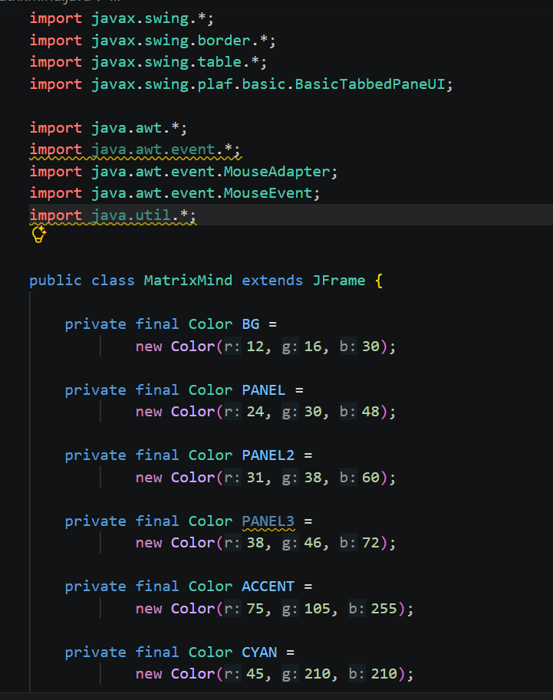
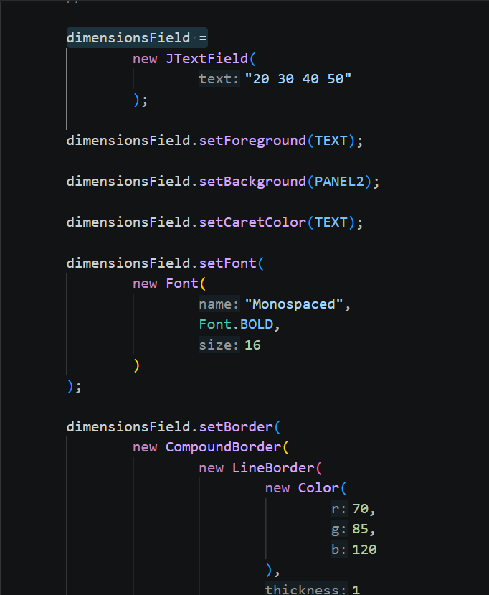
Code:

Slide 9
Results
The developed Java-based tool:
• Accepts matrix dimensions as input.
• Calculates the minimum number of scalar multiplications using Dynamic Programming.
• Displays the optimal parenthesization of the matrix chain.
• Uses Dynamic Programming tables to solve overlapping subproblems efficiently.
• Compares the optimized approach with a naïve strategy.
• Demonstrates the reduction in computational cost.
Complexity:
Time Complexity: O(n³)
Space Complexity: O(n²)

Slide 10
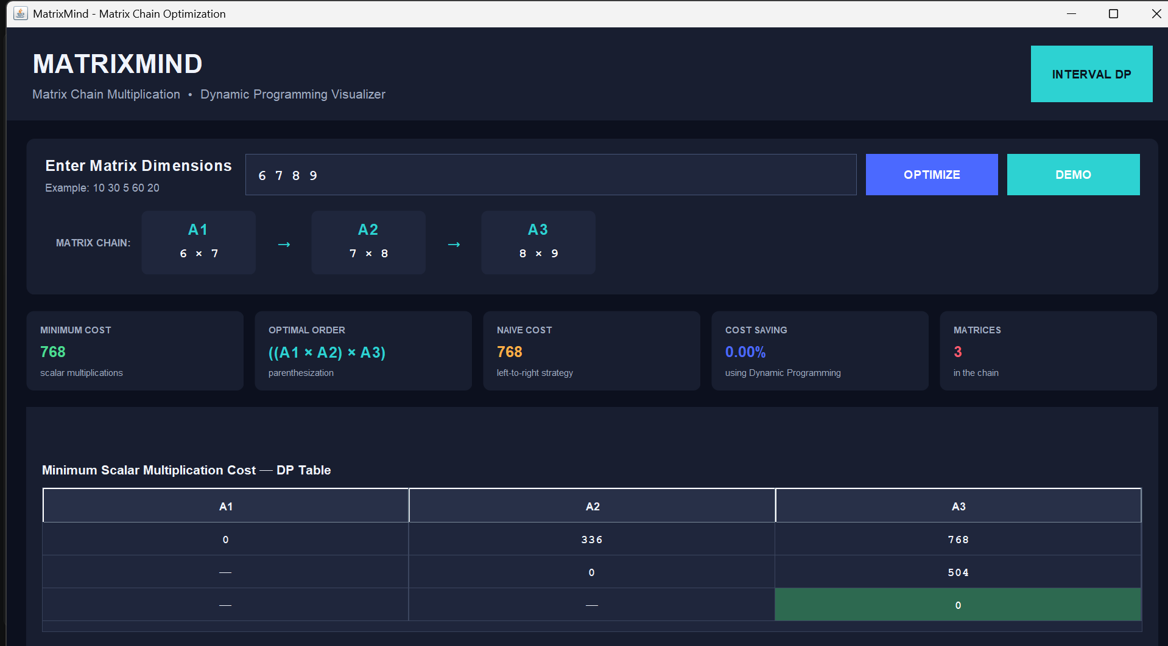
OUTPUT:

Slide 11
Hardware and Software requirements
Hardware Requirements:
Computer/Laptop
Minimum 4 GB RAM
Standard keyboard and mouse
Minimum 500 MB free storage
Software Requirements:
Java Development Kit (JDK)
Java compiler / Java IDE
Operating System: Windows, Linux, or macOS
Any suitable Java development environment
The project is implemented as a Java-based software tool.

Slide 12
Conclusion
• Matrix Chain Multiplication demonstrates how the order of operations can affect computational cost.
• The project uses Interval Dynamic Programming to find the minimum multiplication cost efficiently.
• The Java-based tool identifies the optimal parenthesization for a given matrix chain.
• Comparison with a naïve strategy demonstrates the benefit of optimization.
• The project provides a practical application of Dynamic Programming for solving optimization problems.

Slide 13
Future Scope
• Add an interactive graphical user interface for easier input and visualization.
• Provide step-by-step visualization of the Dynamic Programming table.
• Support larger matrix chains and more detailed performance comparisons.
• Extend the tool to demonstrate other Dynamic Programming optimization problems.
• Improve visualization of optimized versus non-optimized strategies.

Slide 14
Thank you

